Slide 1
TRAVEL EXPLORER WEBSITE
CAPSTONE PROJECT
Presented By:
Sayad Omer Farooq
DRK College of Engineering and Technology
CSE Department

Slide 2
OUTLINE
Problem Statement
System Development Approach
Algorithm & Deployment
Result
Conclusion
Future Scope
References

Slide 3
Problem Statement
Planning a trip can be overwhelming without easy access to destination information.
Users often struggle to find organized data like images, descriptions, and weather updates in one place.
Existing platforms are either cluttered or require switching between multiple sites.
There is a need for a simple, interactive, and visually appealing platform to explore destinations and
plan trips efficiently.

Slide 4
System Approach
Frontend Technologies:
HTML5 – For structuring web pages.
CSS3 – For styling, layout design, and responsiveness.
JavaScript (ES6) – For interactivity and dynamic functionality.
APIs Integrated:
Unsplash API – To fetch high-quality destination images dynamically.
OpenWeatherMap API – To retrieve live weather data for selected destinations.
Design Approach:
Clean, minimalist, and travel-friendly interface.
Mobile-responsive design for all devices.
Modular code separation (HTML, CSS, JS).

Slide 5
Algorithm & Deployment
Development Steps:
Setup Project Structure – Organized folders for assets, HTML, CSS, and JS files.
Homepage Design – Built layout with destination cards and navigation.
API Integration –
Fetch images dynamically from Unsplash API.
Fetch weather details using OpenWeatherMap API.
Destination Details Page – Display detailed info including photo gallery and weather updates.
Testing – Verified API responses, page responsiveness, and error handling.
Deployment – Hosted using GitHub Pages for free and seamless access.

Slide 6
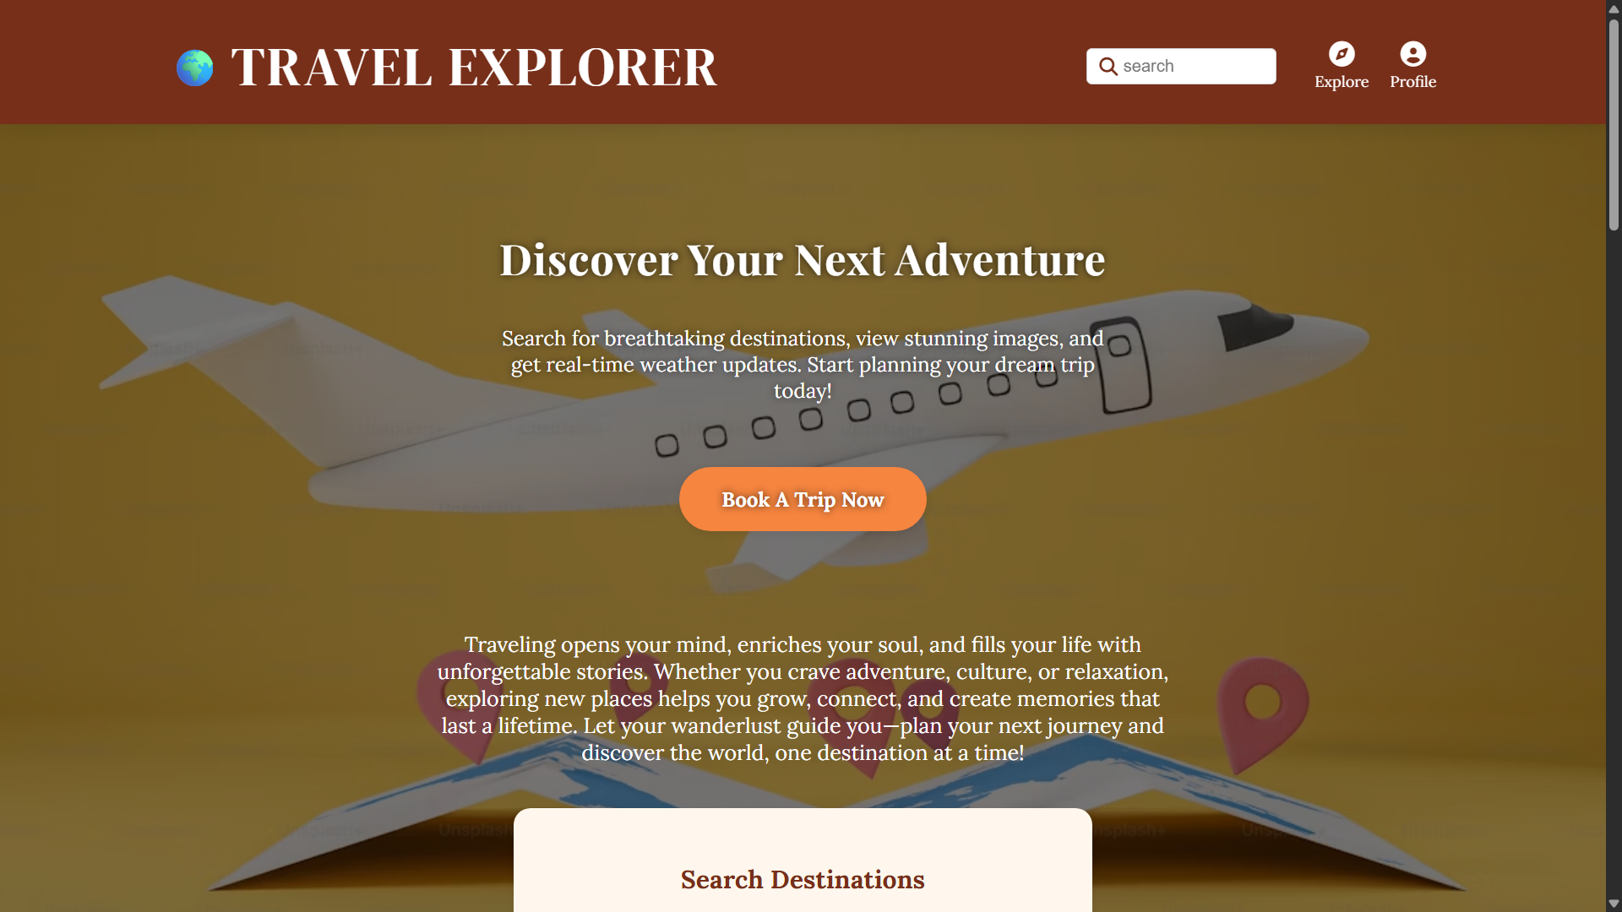
Results : Homepage

Slide 7
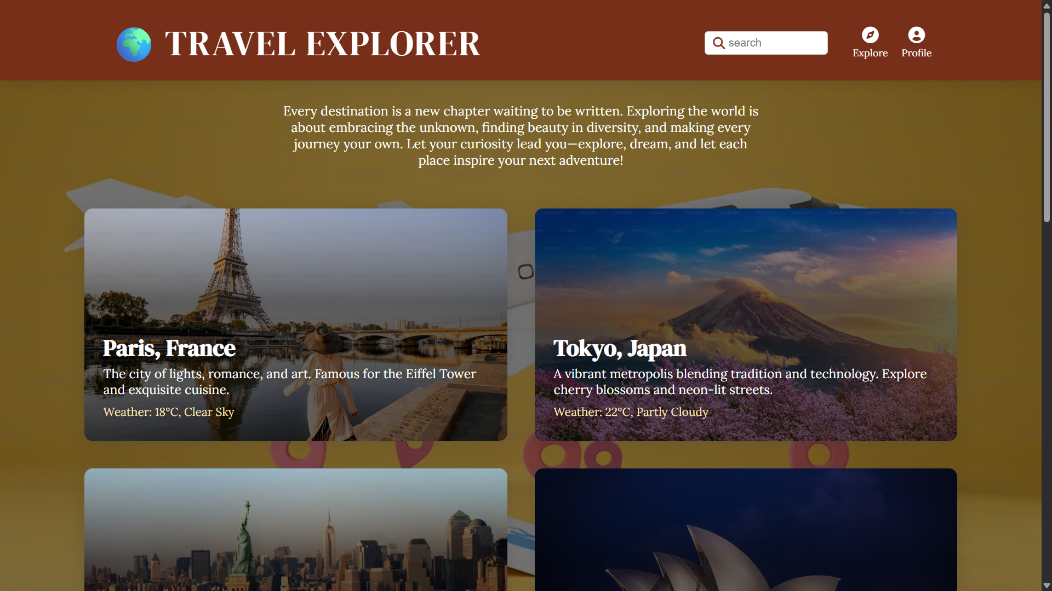
Results : Destinations page

Slide 8
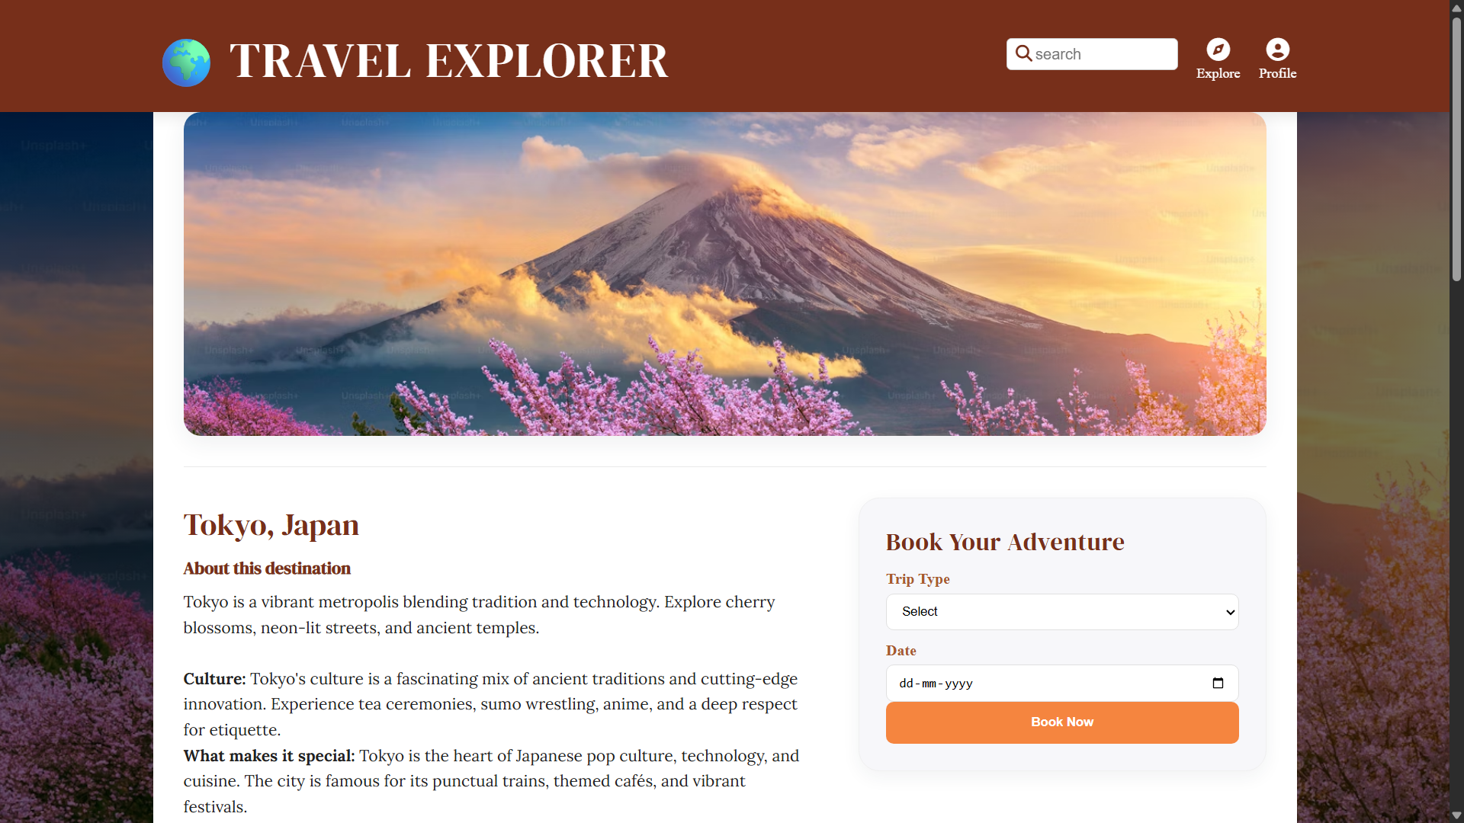
Results : destination details page

Slide 9
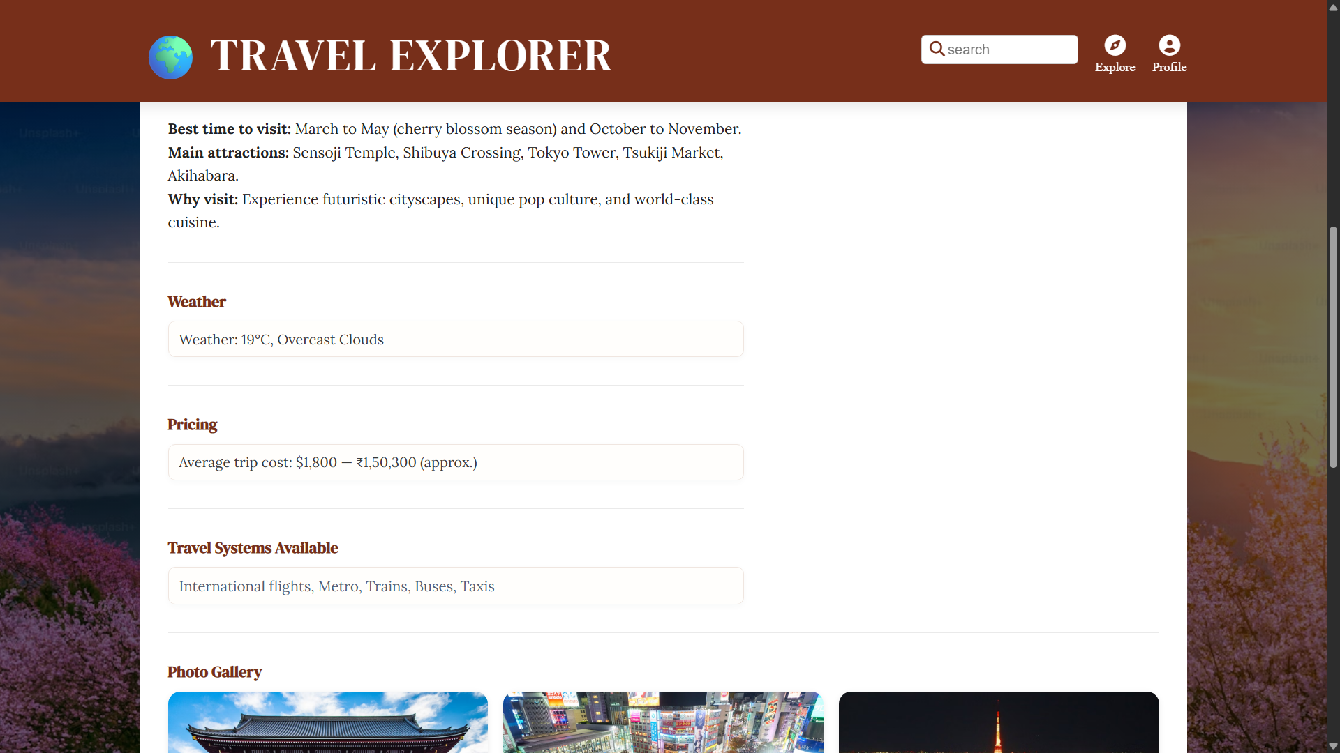
Results : destination details page

Slide 10
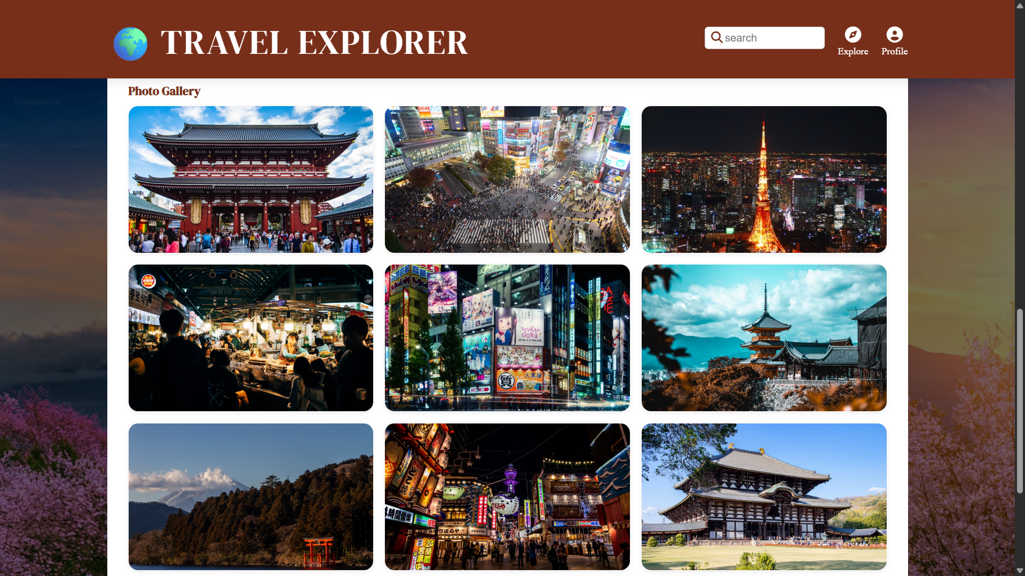
Results : destination details page

Slide 11
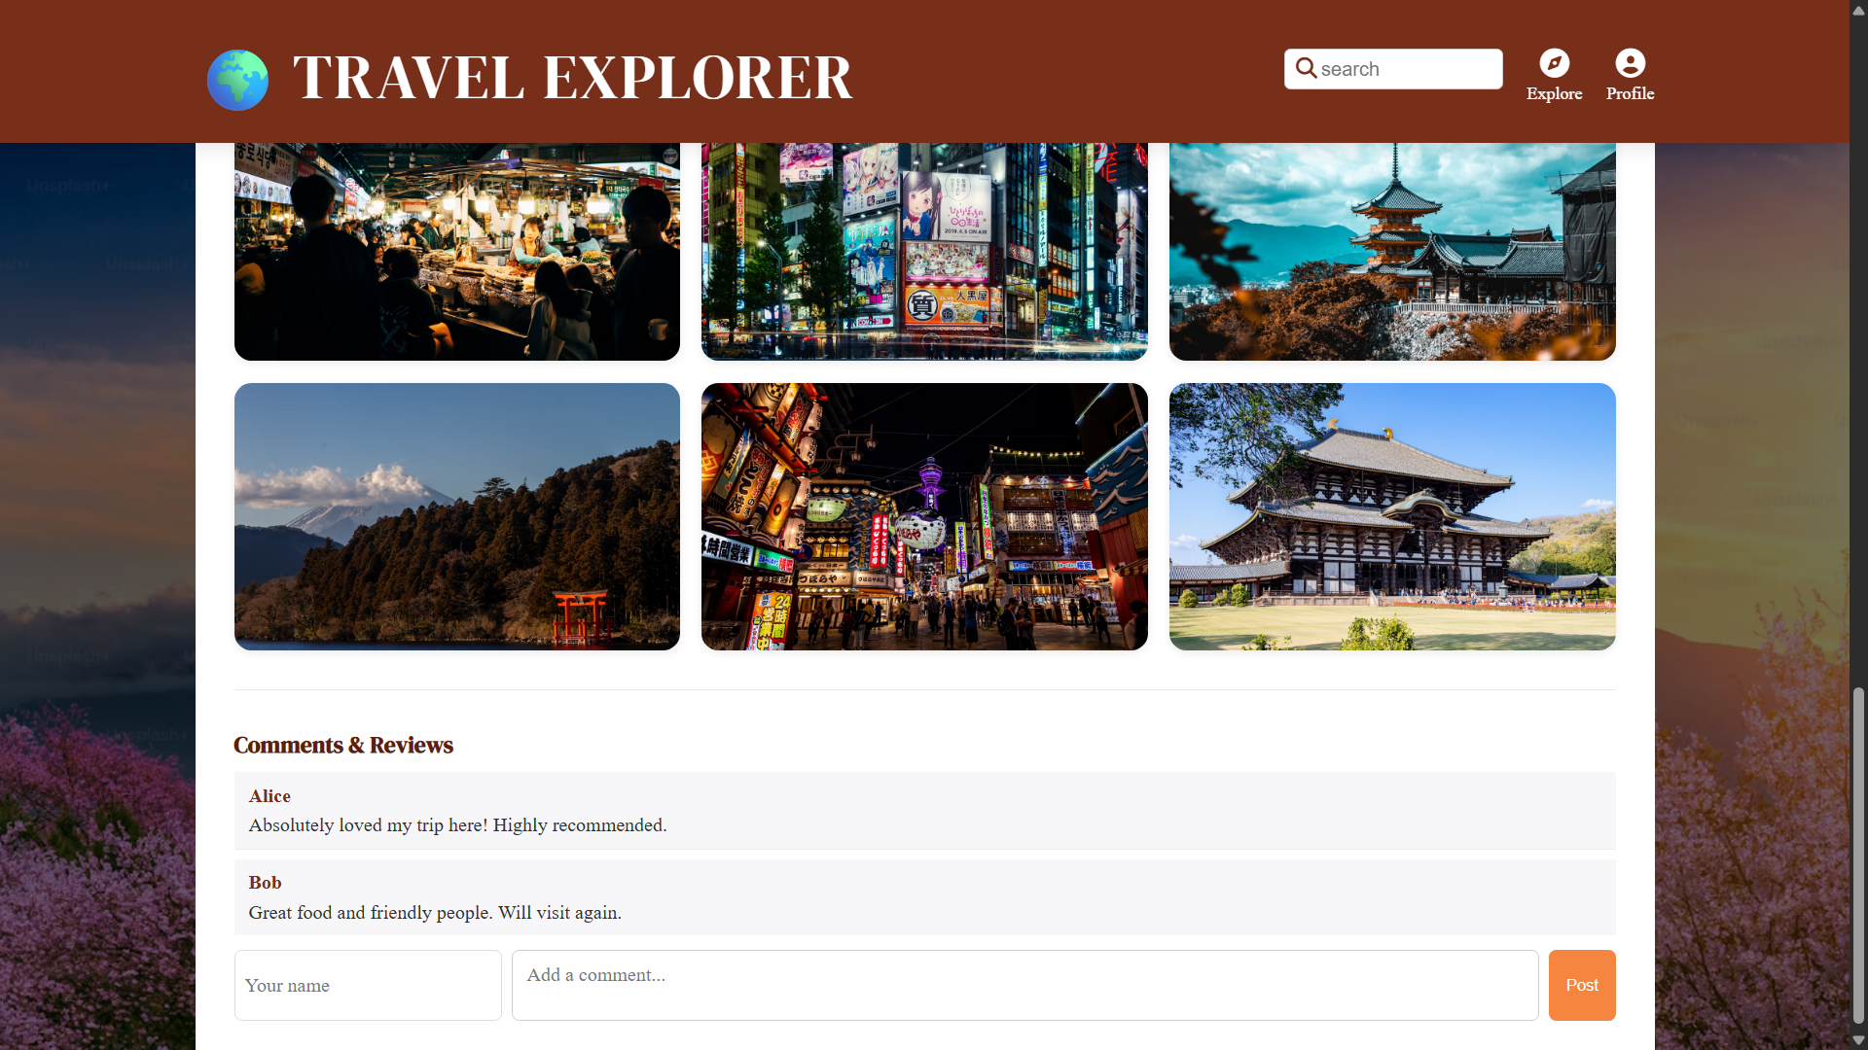
Results : destination details page

Slide 12
GITHUB AND DEPLOYMNET LINK
GitHub Link : https://github.com/omerfarooq25/Travel-Explorer-Website
Deployment link: https://omerfarooq25.github.io/Travel-Explorer-Website/

Slide 13
Conclusion
Simplifies trip planning through a centralized platform.
Offers clean design and seamless experience for exploring destinations.
Enhances user engagement using real-time data via APIs.
Demonstrates strong integration of frontend development and API usage.

Slide 14
Future scope
Add user login and favorites functionality.
Integrate Google Maps API for route and distance visualization.
Enable AI-based recommendations for top destinations.
Add backend (Node.js) for saving trip plans or recent searches.

Slide 15
References
Unsplash API Documentation - https://unsplash.com/developers
OpenWeatherMap API Documentation - https://openweathermap.org/api
W3Schools – HTML, CSS, JavaScript Tutorials - https://www.w3schools.com/
Inspiration - https://www.exploreworldwide.com/ , https://www.exploreworld.com/
Fonts - https://fonts.google.com/
MDN Web Docs - https://developer.mozilla.org/en-US/
GitHub Repository: https://github.com/omerfarooq25/Travel-Explorer-Website
AI Tools : ChatGPT, Gemini Code Assist, GitHub Copilot – For enhancement, design and debugging.

Slide 16
THANK YOU

